Slide 1
Wireless Security
CYS331

Slide 2
Introduction to wireless security
UNIT 1

Slide 3
INTRODUCTION
Wireless is a term used to describe communications in which electromagnetic waves are used for communication purpose.
Wireless security refers to the measures and technologies used to protect wireless networks (Wi-Fi, Bluetooth, cellular networks, etc.) from unauthorized access, cyber threats, and data breaches.
The first wireless transmitters went on the air in the early 20th century using radiotelegraphy.

Slide 4
INTRODUCTION (Continues…)
Modulation made it possible to transmit voices and music via wireless.
Modulating a wave means changing one or more of its fundamental characteristics to encode information.

Slide 5
Example of Wireless
Fixed Wireless
Refers to a method of delivering high-speed internet or network connectivity using radio signals between fixed locations.
It connects buildings, homes, or businesses to the internet without the need for cables.
For example, Cordless Computer Peripherals (e.g., Wireless Mouse, Keyboard, Printers)

Slide 6
Example of Wireless (continues…)
2. IR (Infrared) Wireless
Is a type of wireless communication that uses infrared light waves to transmit data between devices.
It is commonly used for short-range, line-of-sight communication and does not penetrate walls or obstacles.
For example, TV Remote Controls and Medical Devices.

Slide 7
Example of Wireless (continues…)
3. Mobile Wireless
Refers to wireless communication technology that allows users to stay connected while moving.
It enables data transmission without the need for a fixed connection, making it ideal for cell phones, tablets, and other portable devices such as pagers.

Slide 8
Example of Wireless (continues…)
4. Satellite Wireless
Is a communication technology that uses satellites in space to transmit data, voice, and video signals over long distances.
It provides connectivity in areas where traditional cellular or wired networks are unavailable, such as remote regions, oceans, and deserts.
For example, Satellite Internet (e.g., Starlink) and Global Positioning System (GPS).

Slide 9
WIRED VS WIRELESS TECHNOLOGY
 | WIRED | WIRELESS
SPEED | Faster & more stable (Ethernet, fiber optic) | Slower & more variable (Wi-Fi, cellular networks)
INSTALLATION | More complex (requires cables, routers, switches) | Easier (just a router or access point) Ad Hoc Mode – Direct device-to-device communication (No central access point) Infrastructure Mode – Devices connect via a Wi-Fi router or access point
REALIABILITY | Highly stable (less interference) and More secure (physical access needed) | Less stable (affected by interference & distance) and Less secure (susceptible to hacking)
MOBILITY | Cannot provide mobile network and Limited (fixed location) | High (move freely within range)
COST | High (cables, routers, switches, labor) | Lower (just a router or access point)

Slide 10
HOW WIRELESS TECHNOLOGY WORKS
Wireless technology allows devices to communicate without physical cables by using radio waves, infrared, or satellite signals to transmit data.
Transmitter – Sends signals (e.g., Wi-Fi router, cell tower, satellite).
Receiver – Receives signals (e.g., smartphone, laptop, GPS device).
Medium – The air (radio waves, infrared, microwave, etc.).
Protocols – Rules for communication (Wi-Fi, Bluetooth, 4G/5G, etc.).

Slide 11

TYPES OF TECHNOLOGIES
Wi-Fi (Wireless Fidelity)
.
Is a generic term that refers to the IEEE 802.11 communications standard for Wireless Local Area Networks (WLANs).
When Wi-Fi enabled device encounters a hotspot, the device can then connect to that network wirelessly.

Slide 12
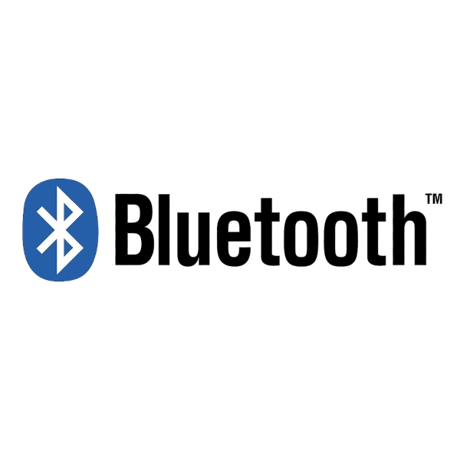
TYPES OF TECHNOLOGIES (continues…)
Bluetooth
.
Is a wireless technology for transferring data between two devices that are in close proximity with each other.

Slide 13
ADVANTAGES & disadvantages OF WIRELESS TECHNOLOGY
 | ADVANTAGES (PROS) | DISADVANTAGES (CONS)
Mobility | Devices can connect anywhere within range | Signal weakens with distance & obstacles
Installation | No cables, easy & quick setup | Requires a router, access points, or mobile networks
Cost | No need for expensive cabling | Long-term costs (router upgrades, bandwidth fees) can add up
Speed | 5G & Wi-Fi 6 offer fast speeds | Generally slower than wired connections, especially under heavy usage
Security | Can use encryption (WPA3, VPNs) for protection | Susceptible to hacking, unauthorized access, and signal interception

Slide 14
Applications Of Wireless Technology
Remote Control
Wireless technology enables remote operation of devices such as TVs, drones, garage doors, and industrial machinery.
Infrared (IR) and radio frequency (RF) signals are commonly used for this purpose.

Slide 15
Applications Of Wireless Technology (continues…)
2. Item Tracking
Wireless tracking technologies like RFID (Radio-Frequency Identification) and GPS (Global Positioning System) help monitor the location of valuable assets, inventory, and personal belongings in real time.

Slide 16
Applications Of Wireless Technology (continues…)
3. Navigation And Location
The Global Positioning System (GPS) is a space-based Global Navigation Satellite System (GNSS) that provides location and time information.

Slide 17
Applications Of Wireless Technology (continues…)
4. Wireless Power Transfer
Is a technology that allows electrical energy to be transmitted from a power source to a device without using physical wires.
For example, Smartphone and Electric Vehicle (EV) Wireless Charging.

Slide 18
Applications Of Wireless Technology (continues…)
5. Remote Monitoring
Wireless sensors and IoT (Internet of Things) devices help monitor health (wearable devices), industrial machines, and smart homes for security, temperature control, and energy management.

Slide 19
Applications Of Wireless Technology (continues…)
6. Risk Management
Wireless surveillance systems, fire alarms, and disaster monitoring networks help detect potential threats and mitigate risks in security, environmental protection, and industrial operations.

Slide 20
Wireless data networks
Unit 2

Slide 21
introduction
We can say that wireless networks are those which are not connected by any type of cables and it uses different wireless connections between network nodes.
These networks allow devices like smartphones, laptops, and IoT devices to connect and exchange data over a distance.

Slide 22
Need of wireless data networks
 | NEED
Mobility & Convenience | Users can stay connected without being tied to a physical cable. Ideal for mobile devices, allowing access to the internet anywhere (home, office, public spaces).
Scalability & Flexibility | Easy to expand without adding new cables.
Cost-Effective | Reduces costs related to cabling, installation, and maintenance.
Facilitates Public Wi-Fi & Hotspots | Used in cafés, airports, schools, and shopping malls to provide internet access.
Connectivity in Remote Areas | Provides internet access where wired infrastructure is unavailable, such as rural areas, disaster zones, and mobile networks (3G, 4G, 5G, satellite internet).

Slide 23
Benefits & Disadvantages of wireless data networks
BENEFITS | DISADVANTAGES
Mobility & Convenience – Users can connect from anywhere without being tied to cables. | Security Risks – Wireless networks are more vulnerable to hacking, interception, and unauthorized access.
Cost-Effective – Reduces costs associated with cabling, installation, and maintenance. | Slower Speeds Compared to Wired Networks
 | Limited Range – Wi-Fi signals have a limited coverage area.
 | Interference – Signals can be weakened by walls

Slide 24
Types of wireless data networks
Wireless Local Area Network (WLAN)
Used in homes, offices, and public places to connect multiple devices within a limited range.
For example Wi-Fi.
In a Local Area Network (LAN) a group of computers and other devices have a common wireless network within a distinct area.
Wireless Router
Laptop
Laptop

Slide 25
Types of wireless data networks (Continues…)
Types of WLANs
Infrastructure – Devices connect via a Wi-Fi router or access point.
Peer-to-Peer or Ad Hoc – Direct device-to-device communication (No central access point).
Wireless Distribution System – Wireless is expanded using multiple access points without the need for wired backbone to link them.

Slide 26
Types of wireless data networks (Continues…)
2. Wireless Metropolitan Area Network (WMAN)
Covers a city or large campus, providing high-speed wireless internet over long distances.
This cover a wide area than Local Area Network (LAN) but less than the Wireless Wide Area Network (WWAN).
For example, WiMAX.

Slide 27
Types of wireless data networks (Continues…)
In this wireless network type, access points are placed on the poles or on the buildings through the area.
When users are connecting to their destination they are connected to the nearest access point.
WiMAX Tower
WiMAX Tower

Slide 28
Types of wireless data networks (Continues…)
ADVANTAGES | DISADVANTAGES
Sharing of connections – In metropolitan area network it is a combination of two or more LAN networks | Difficulty in managing – It may be difficult to manage if number of lines are increased. This is due to the security purposes.
Security level – It has high security than WAN
Cost – It is less expensive with good data efficiency
High speed – The speed in this network is fast because MAN uses fiber optics | Speed – Of network may be slow due to high coverage

Slide 29
Types of wireless data networks (Continues…)
3. Wireless Personal Area Network (WPAN)
Covers a short range (a few meters e.g., 100) for connecting personal devices like phones, smartwatches, and wireless earbuds.
For example, Bluetooth, Zigbee, UWB.
Phone
Phone

Slide 30
Types of wireless data networks (Continues…)
BENEFITS | DISADVANTAGES
No need of data cables | Transferring of data may be slow
Data can be transfer between multiple devices at a time | It can only be used in personal area limited coverage
Not much costly

Slide 31
Types of wireless data networks (Continues…)
4. Wireless Wide Area Network (WWAN)
It is different from the rest of the networks because it uses mobile telecommunications and other cellular technologies like 2G, 3G, 4G and 5G in transferring of data.
It basically covers a large geographical area.
Lusaka
WWAN
Ndola

Slide 32
Wireless Personal Area Network (wpan)
UNIT 3

Slide 33
IEEE definition of WPAN
Wireless Personal Area Networks (WPANs) are used to convey information over short distances among a private, intimate group of participant devices.

Slide 34
WPAN TECHNOLOGIES
BLUETOOTH
Is a cable-replacement technology that can be used to connect almost any device to any other device.
It as a radio interface enabling electronic devices to communicate wirelessly via short range (10 meters) ad-hoc radio connections.
Uses the radio range of 2.45 GHz.
Theoretical maximum bandwidth is 1 Mb/s.

Slide 35
WPAN TECHNOLOGIES (continues…)
Bluetooth Products
Personal Computers (PCs)
Printers
Cell Phones
Headsets & Speakers
Cameras

Slide 36
WPAN TECHNOLOGIES (continues…)
Bluetooth Architecture
Piconet
Several Bluetooth devices can form an ad hoc network called a “piconet”.
Each piconet has one master and up to 7 simultaneous slaves.
Master – device that initiates a data exchange.
Slave – device that responds to the master.
All devices in a piconet hop together, master gives slaves its clock and device ID.
Non-piconet devices are in standby.

Slide 37
WPAN TECHNOLOGIES (continues…)
A Piconet is a small Bluetooth network consisting of one master device and up to seven active slave devices.
There can also be devices in a non-active state:
Standby Mode – A Bluetooth device is not connected to any piconet but is waiting for connection requests.
Parked Mode – A device is connected to the piconet but not actively participating in data exchange. Parked devices do not have an active address but can be reactivated by the master.
Parked
Stand By
Slave
Slave
Master
Stand By
Slave
Parked

Slide 38
WPAN TECHNOLOGIES (continues…)
ii. Scatternet
Is the linking of multiple piconets through the master or slave devices.
Devices can be slave in one piconet and master of another.
Scatternet

Slide 39
WPAN TECHNOLOGIES (continues…)
Physical links
Between master and slave(s), different types of links can be established.
Synchronous Connection Oriented (SCO)
Support symmetrical, circuit-switched, point-to-point connections.
Typically used for voice traffic.
Data rate is 64 kbit/s.

Slide 40
WPAN TECHNOLOGIES (continues…)
ii. Asynchronous Connection-Less (ACL)
Support symmetrical and asymmetrical, packet-switched, point-to-multipoint connections.
Typically used for data transmission.
Data rate is 433.9 kbit/s in symmetric or 723.2/57.6 kbit/s in asymmetric.

Slide 41
WPAN TECHNOLOGIES (continues…)
BLUETOOTH SECURITY
Authentication | Ensures that devices communicating over Bluetooth are legitimate and trusted. Uses pairing and mutual authentication to verify the identity of devices before establishing a connection. Authentication is performed using a shared secret key generated during the pairing process.
Confidentiality | Protects Bluetooth communication from eavesdropping by encrypting transmitted data. Uses symmetric encryption (such as E0 stream cipher) to prevent unauthorized access.
Authorization | After authentication, the master device determines which services the slave device can access. For example, a Bluetooth headset may be allowed to access audio functions but not transfer files from your phone

Slide 42
WPAN TECHNOLOGIES (continues…)
2. ZigBee
Is a technological standard designed for control and sensor networks.
Based on the IEEE 802.15.4 Standard.
Created by the ZigBee Alliance.

Slide 43
WPAN TECHNOLOGIES (continues…)
Characteristics
Low cost
Low power consumption
Low data rate
Scalability
Reliability
Flexibility
Relatively short transmission rate

Slide 44
WPAN TECHNOLOGIES (continues…)
ZIGBEE SECURITY
Authentication | Ensures only trusted devices can join the network.
Encryption | Uses AES-128 encryption to protect data from eavesdropping. CTR (Counter Mode) – Used for encryption, turning plaintext into ciphertext using a counter value.
Integrity | Prevents message tampering using Message Integrity Codes (MIC). CBC-MAC (Cipher Block Chaining – Message Authentication Code) – Used for data integrity, ensuring messages are not altered.
Access Control | Devices must have an authorized key to communicate.

Slide 45
WPAN TECHNOLOGIES (continues…)
ZigBee Applications
Home Automation – Smart lighting and remote-controlled appliances.
Industrial Automation
Healthcare & Medical Devices – Patient monitoring systems and wearable health devices.

Slide 46
WPAN TECHNOLOGIES (continues…)
ZigBee Topologies
A topology is the arrangement or structure of a network, defining how devices are interconnected and communicate with each other.
Star – is a network configuration where all devices are connected to a central hub or switch, which manages data transmission between them.
Mesh – is a network configuration where each device is interconnected with multiple other devices, ensuring redundancy and reliable communication.
Cluster Tree – is a network structure where devices are organized into hierarchical clusters, with a central coordinator managing communication and routing data between clusters.

Slide 47
WPAN TECHNOLOGIES (continues…)
Cluster Tree
Mesh
ZigBee Topologies
Star

Slide 48
WPAN TECHNOLOGIES (continues…)
 | ADVANTAGES | DISADVANTAGES
Star | Easy to install and manage. A failure in one device does not affect the entire network. | Failure of the central hub disrupts the network. More cabling is required, increasing cost.
Mesh | Provides redundancy and fault tolerance. | Expensive to implement due to high cabling and hardware costs. Complex configuration and maintenance.
Cluster Tree | Scalable and supports large networks. Efficient power consumption, making it suitable for wireless sensor networks. | Failure of a parent node can isolate entire clusters.

Slide 49
WPAN TECHNOLOGIES (continues…)
ZigBee and Bluetooth Comparison
 | BLUETOOTH | ZIGBEE
Power Profile | Days | Years
Complexity | Complex | Simple
Nodes | 7 | 64000
Latency | 10 seconds | 30ms – 1s
Range | 10m | 70m – 300m
Extendibility | No | Yes
Data Rate | 1Mb/s | 250kb/s
Security | 64-bit, 128-bit | 128-bit AES

Slide 50
WPAN TECHNOLOGIES (continues…)
3. Ultra Wide Band (UWB)
Is a technology for short range Wireless radio communications.
It as a bandwidth more than 25% of a center frequency or more than 1.5 GHz.

Slide 51
Wireless Transmission Media
UNIT 4

Slide 52
Wireless Transmission
Wireless transmission is a form of unguided media.
Wireless signals are spread over in the air and are received and interpreted by appropriate antennas.
Some generation of wireless communication include;
1st Generation (1G)
2nd Generation (2G)
3rd Generation (3G)
4th Generation (4G)
5th Generation (5G)

Slide 53
Types of Wireless transmission
Radio Wave
Is an electromagnetic phenomenon which travels through space and through many non-magnetic materials.
They range from 3 KHz to 3000 GHz and also classified as –
Low Frequency – 30 to 300 KHz.
Medium Frequency – 300 to 3000 KHz.
High Frequency – 300 to 3000 GHz.

Slide 54
Types of Wireless transmission (Continues…) Advantages of Radio waves
Speed – electromagnetic waves of any kind are the fastest things in the universe.
Penetration Power – can pass through obstacles.
Low Power Consumption – efficient for wireless devices.
Cost-Effective – low infrastructure costs.

Slide 55
Types of Wireless transmission (Continues…) Disadvantages of Radio wave

Slide 56
Types of Wireless transmission (Continues…) Characteristics of a Radio wave
Radio wave is a method of transmitting intelligence from one location to another by means of electromagnetic radiation.
Radio waves can travel through long distances and penetrate through materials unlike light and heat waves.
Radio waves are invisible.
Radio waves are normally not felt.
Radio waves have frequencies as high as 300 GHz to as low as 30 Hz.

Slide 57
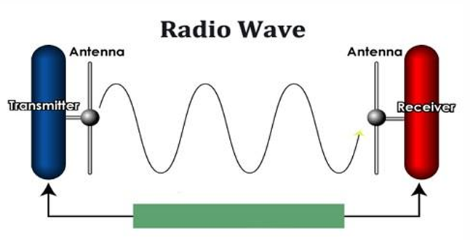
Types of Wireless transmission (Continues…) Application of radio wave
Radio waves carry signal for AM and FM radio.
It is highly use in cellular telephones and Television.
Radio waves are useful for Police and Radar.

Slide 58
Types of Wireless transmission (Continues…)
Microwave
Travels in straight lines, both sender and receiver must be aligned to be strictly in line-of-sight.
Microwaves can have wavelength ranging from 1 mm – 1 meter and frequency ranging from 300 MHz to 300 GHz.
Microwave transmission depends highly upon the weather conditions and the frequency it is using.
Microwaves are used for unicast communication such as cellular telephones, satellite networks and WLANs.

Slide 59
Types of Wireless transmission (Continues…) types of Microwave
Terrestrial Microwave
Is a wireless microwave networking technology that uses line-of sight communications between pairs of Earth-based transmitters and receivers to relay information.
It is the most common form of long-distance communication.
Its characteristics include –
Fewer Repeaters but requires line of sight transmission.
Main source of loss is attenuation caused mostly by distance, rainfall and interference.
Common frequencies used for transmission are in the range 1 to 40 GHz.

Slide 61
Types of Wireless transmission (Continues…) types of Microwave (Continues…)
Satellite Microwave
Uses satellites for broadcasting and receiving of signals.
These systems need satellites which are in the geostationary orbit which is 3600 km above the earth.
Its advantages include –
No cables needed
Multiple channels available
Wide bandwidth

Slide 62
Types of Wireless transmission (Continues…) types of Microwave (Continues…)
Its disadvantages include –
Expensive towers and repeaters
Subject to interference such as passing airplanes and rain
Line of sight requirement
Its major characteristic is the optimum frequency range for satellite transmission is 1 to 10 GHz.

Slide 63
Types of Wireless transmission (Continues…) types of Microwave (Continues…) Applications of Satellite Microwave
Television distribution
Long distance telephone transmission
Global Positioning System (GPS)

Slide 64
Types of Wireless transmission (Continues…)
Infrared (IR)
Involves sending light signals at a frequency between visible light and radio waves.
Commonly used in TV remote controls, now is used to provide LAN connections.
It is a line-of-sight transmission and has a maximum coverage of 30 to 80 feet.

Slide 65
Types of Wireless transmission (Continues…) Characteristics of IR
Sends signals through infrared light.
Sending a signal in a straight line.
Cannot penetrate through the surface of the object.
It is generally used for short distance transmission such as a TV remote.
It does not require an antenna to operate.

Slide 66
Types of Wireless transmission (Continues…) applications of IR
Remote controls for television.
Wireless LANs.
Intrusion Detection Systems (IDS).

Slide 67
WIRELESS SECURITY THREATS
UNIT 5

Slide 68
Security Treat & Breach
A threat is any potential danger that can exploit a vulnerability in a system or network to cause harm, damage, or unauthorized access to data, resources, or services.
In other words, it is anything that can compromise the confidentiality, integrity, or availability of information or systems.
A security breach is an incident where unauthorized individuals gain access to a system, network, or data, violating the system’s security policies.

Slide 69
Security Treat & Breach (Continues…)
Aspect | Threat | Breach
Timing | Before the attack | After the attack
Action | Potential attack | Successful attack
Impact | No damage yet | Actual damage/loss
Examples | Malware, phishing attempts, unpatched software | Data theft, system compromise, information leak

Slide 70
Security Threats
Eavesdropping
Is the act of secretly or stealthily listening to the private conversation or communications of others without their consent in order to gather information.
Eavesdropping is especially dangerous because wireless signals travel through the air and can be intercepted without physical access.
For example, using Wireshark to capture data from users connected to the public Wi-Fi to steal unencrypted data such as passwords, emails, or credit card numbers.

Slide 71
Security Threats (Continues…)
Types of Eavesdropping
Prevention of Eavesdropping
Passive – Just listens to data without altering it.
Active – May inject queries or interfere to gather more data.
Encryption - WPA3 for Wi-Fi, SSL/TLS for web.
VPNs
Avoid using public Wi-Fi for sensitive tasks.

Slide 72
Security Threats (Continues…)
Communication Jamming
Refers to the deliberate interference with wireless communications.
It is a form of Denial of Service (DoS) attack specifically aimed at wireless communication channels.

Slide 73
Security Threats (Continues…)
Types of Jamming
Spot – Used to block a single communication channel.
Sweep – Moves a jamming signal across multiple frequencies.
Barrage – Jams a wide range of frequencies at once.
Deceptive - Sends fake signals to mislead or confuse receivers.

Slide 74
Security Threats (Continues…)
Effects and Risks of Jamming
Countermeasures of Jamming
Loss of communication
Interruption of Wi-Fi
Loss of service on commercial networks
Frequency hopping
Spread spectrum
Shielding and filtering
Signal detection

Slide 75
Security Threats (Continues…)
Radio Frequency (RF) Interference
RFI also known as electromagnetic interference (EMI) is when external signals mess with the wireless signals.
RF interference can be intentional (like jamming) or unintentional (accidental).

Slide 76
Security Threats (Continues…)
Sources of RF Interference
Effects of RF Interference
.
Dropped calls in mobile networks
Poor Wi-Fi performance
Disrupted broadcast signals (TV, radio)
Errors in sensitive instruments (e.g., medical equipment)
Natural | Man-made
Lightning | Cell phones and towers
Solar flares | Wi-Fi routers
Cosmic radiation | Radios and TVs

Slide 77
Security Threats (Continues…)
Types of RF Interference
Co-channel interference – Occurs when two transmitters use the same frequency channel.
Adjacent-channel interference – Happens when signals from nearby channels overlap.
Intermodulation interference – Caused when multiple RF signals mix together and produce unwanted frequencies.
Harmonic interference – Comes from signals that are multiples of a base frequency, unintentionally picked up by other devices.

Slide 78
Security Threats (Continues…)
Prevention & Mitigation of RFI
Shielding & Filtering
Spread Spectrum

Slide 79
Security Threats (Continues…)
Structured Query Language Injection (SQLi)
Is a code injection attack where a malicious user inserts or "injects" harmful SQL code into input fields or parameters of an application allowing attackers to interfere with the queries an application makes to its database.
It’s effects include;
Unauthorized access to sensitive data
Modify or delete data in the database
Control the entire database by administrative privilege escalation

Slide 80
Security Threats (Continues…)
How to Prevent SQL Injection
User input validation
Least privilege principle
Regularly update and patch software

Slide 81
Security Threats (Continues…)
Denial of Service (DoS)
Is a malicious attempt to make a computer, server, or network resource unavailable to its intended users either temporary or permanently by overwhelming it with a flood of fake traffic or requests.

Slide 82
Security Threats (Continues…)
Types of DoS Attacks
Volume-Based Attacks – Flood the target with huge amounts of traffic (e.g., UDP Flood, ICMP Flood)
Protocol Attacks – Exploit weaknesses in network protocols (e.g. Ping of Death) so as to exhaust server resources like CPU or memory
Application Layer Attacks – Target specific apps or services (e.g., HTTP Flood) so as to exhaust the application’s resources
Others
Buffer Overflow (Stack And Heap)
SYN Flood/ Half-open attack
Teardrop
Smurf

Slide 83
Security Threats (Continues…)
Spoofing
Is a cyberattack where an attacker pretends to be someone else by faking data to trick a system or user into trusting them.
This can be done on;
IP Address (IP Spoofing)
Email Address (Email Spoofing)
MAC Address (MAC Spoofing)
Caller ID (Caller ID Spoofing)
Website/URL (Website Spoofing)

Slide 84
Security Threats (Continues…)
Reasons for spoofing
How to Protect Against Spoofing
To bypass security controls
To steal data or credentials
To hide their true identity
Encryption – HTTPS and VPNs
Email authentication – SPF, DKIM and DMARC
Network security measures – Firewalls, honey pots, ACLs, IPS and IDS
Awareness

Slide 85
Traffic Analysis
Unit 6

Slide 86
Traffic Analysis
Is the process of monitoring, capturing, and examining wireless network traffic to gather information about communication patterns, even if the actual content is encrypted.
It analyzes metadata and observable characteristics of network traffic flows, such as Source & Destination Addresses/MACs and Packet Sizes & Lengths.
Unlike eavesdropping which aims to decrypt content, TA infers, meaning from the context and pattern of the communication, it gather information even when content is encrypted.

Slide 87
Why is TA a Critical Threat in Wireless
Networks?
Inherent Broadcast Medium/Security – Wireless signals propagate through the air, making them inherently easier to intercept.
Metadata Exposure – While encryption (WPA2/WPA3) protects payload content, fundamental metadata (source, destination, size, timing) is often still visible in unencrypted frame headers or easily observable patterns.
Defeating Encryption – TA bypasses strong encryption algorithms.
Stealth – Passive TA is extremely difficult to detect.

Slide 88
Types of Traffic Analysis Attacks
Passive Attacks
Active Attacks
The attacker only listens and doesn't inject traffic or disrupt communications.
It can be done through monitoring, pattern recognition, correlation attacks and social network analysis.
The attaker inject traffic or disrupt communications.
It can be done through packet injection, traffic generation and selective jamming.

Slide 89
Common TA Techniques & Tools
Techniques
Tools
Flow Analysis
Statistical Analysis
Time-Series Analysis
Website Fingerprinting
Entropy Analysis
Machine Learning (ML)
Wireshark
tcpdump
Aircrack-ng suite

Slide 90
Wireless Security Standards
UNIT 7

Slide 91
Wireless Security Standards
Wireless security standards are protocols designed to protect wireless networks (Wi-Fi) from unauthorized access, data breaches, and interference.
Wired Equivalent Privacy (WEP)
Introduced in 1997 as part of the original Institute of Electrical and Electronics Engineers (IEEE) 802.11 standard.
The goal was to provide privacy similar to that of wired networks.
It uses Rivest Cipher 4 (RC4) stream cipher for encryption and an Initialization Vector (IV) 24-bit field added to it.
Key length 64-bit (40-bit key + 24-bit IV) or 128-bit (104-bit key + 24-bit IV).
Authentication methods include Open System (any device can authenticate) and Shared Key (devices authenticate using a shared secret)

Slide 92
Wireless Security Standards (Continues…)
Weaknesses of WEP
Real-World Attack
IVs are too short and frequently reused
RC4 is vulnerable to statistical attacks
Key reuse makes WEP vulnerable to replay attacks
Tools like Aircrack-ng can capture encrypted packets and use them to recover WEP keys.
Declared insecure by the Wi-Fi Alliance in 2004.

Slide 93
Wireless Security Standards (Continues…)
Wi-Fi Protected Access (WAP)
Introduced in 2003 by the Wi-Fi Alliance.
Interim solution to replace WEP until IEEE 802.11i was finalized.
It uses a Temporal Key Integrity Protocol (TKIP) which dynamically generates new keys for every packet and appends a Message Integrity Check (MIC) to detect tampering.
Still uses RC4 for encryption.

Slide 94
Wireless Security Standards (Continues…)
WPA modes
Weaknesses & Real-World Attack
WPA-Pre-Shared Key (PSK) – For home users.
WPA-Enterprise – Uses IEEE 802.1X authentication and a Remote Authentication Dial-In User Service (RADIUS) server.
TKIP still relies on RC4, inheriting many of its weaknesses
Vulnerable to replay attacks and MIC key recovery
Beck-Tews attack allows packet injection by exploiting TKIP flaws

Slide 95
Wireless Security Standards (Continues…)
Wi-Fi Protected Access II (WPA2)
Released in 2004, based on the IEEE 802.11i amendment.
Made mandatory for Wi-Fi certified devices by 2006.
It used Advanced Encryption Standard (AES) and Counter Mode with Cipher Block Chaining Message Authentication Code Protocol (CCMP).
Provides both encryption and message integrity.
Uses a 4-way handshake to establish encryption keys.
Authentication Modes include WPA2-PSK and WPA2-Enterprise.
Key Reinstallation Attack (KRACK) vulnerability of 2017 exploits flaws in the 4-way handshake process to reinstall already-used keys.

Slide 96
Wireless Security Standards (Continues…)
Wi-Fi Protected Access III (WPA3)
Introduced in 2018 to overcome WPA2 limitations.
Replaces WPA2’s PSK with Simultaneous Authentication of Equals (SAE) which is based on Password-Authenticated Key Exchange (PAKE), providing resistance to dictionary attacks.
Past session keys remain secure even if a current key is compromised (Forward Secrecy).

Slide 97
Wireless Security Standards (Continues…)
Additional Features
Vulnerability
Opportunistic Wireless Encryption (OWE) – Provides encrypted communication in open networks
Wi-Fi Easy Connect – Uses Device Provisioning Protocol (DPP) to connect IoT (Internet of Things) devices securely via QR codes
Dragonblood attacks (2019) – Exploited implementation flaws in the SAE protocol, now mitigated in updates

Slide 98
Wireless Security Standards (Continues…)
Wireless LAN Security (IEEE 802.11i)
Finalized in 2004 and introduced the Robust Security Network (RSN) concept.
It’s features included;
AES-CCMP
802.1X
Key management, authentication, and data integrity

Slide 99
Wireless Security Standards (Continues…)
Port-Based Network Access Control (IEEE 802.1X)
Provides a framework for authenticating and authorizing devices on a network.
It’s components include;
Supplicant - The client device requesting access
Authenticator – Network device (e.g., Access Point or Switch)
Authentication Server - Usually a RADIUS server

Slide 100
Wireless Security Standards (Continues…)
Extensible Authentication Protocol (EAP) Variants Used in IEEE 802.1X
EAP-Transport Layer Security (TLS) – Uses client and server certificates
Protected EAP (PEAP) – Encapsulates EAP inside a TLS tunnel
EAP-Tunneled Transport Layer Security (TTLS)

Slide 101
4-way handshake
Is a process used in wireless security protocols, particularly Wi-Fi Protected Access protocols, to establish a secure connection between a Wi-Fi client (like your laptop or phone) and a Wi-Fi access point (router).
Its purpose is to;
To confirm both the client and access point know the Pre-Shared Key (PSK) or use 802.1X authentication.
To generate and exchange encryption keys (called Pairwise Transient Keys or PTKs).
To protect against replay and man-in-the-middle attacks.

Slide 102
4-way handshake (Continues…)
Client (Supplicant)
Authenticator (Access Pont)
.
PMK
Anonce
PMK
Snonce + MIC
PTK
PTK

Slide 103
WIRELESS TRANSPORT LAYER SECURITY(WTLS)
UNIT 8

Slide 104
WIRELESS TRANSPORT LAYER SECURITY (WTLS)
WTLS is a security protocol specifically designed for wireless networks, particularly for devices using the Wireless Application Protocol (WAP).
WTLS is based on TLS (Transport Layer Security), but it's optimized for wireless environments where bandwidth, processing power, and memory are limited.
Below are some reasons why we need WTLS;
Communication
Using Internet

Slide 105
TRANSPORT LAYER SECURITY (TLS)
TLS (Transport Layer Security) is a cryptographic protocol designed to provide secure communication over a computer network, such as the internet.
Transport Layer Security (TLS) is a slightly modified version of SSL version 3.
WTLS Functions include –
Integrity
Authentication
Privacy

Slide 106
WTLS Specifications
Full Handshaking
A Full Handshake is used when –
The client and server have no prior session or session data (i.e., first-time connection).
The session must establish new keys, perform certificate validation, and negotiate security parameters from scratch.

Slide 107
WTLS Specifications (Continues…)
Key Features of a full handshake include –
Exchange of client and server certificates (if required).
Generation of new session keys.
Longer time and processing due to complete setup.
More secure, especially when no trust has been previously established.

Slide 108
WTLS Specifications (Continues…)
Abbreviated Handshaking
An Abbreviated Handshake is used when –
The client and server have previously communicated.
They use cached session data to resume a previous secure connection.
Its key features include –
Faster connection setup.
Reuses previous session keys or resumption secrets.
Saves on CPU, memory, and bandwidth.

Slide 109
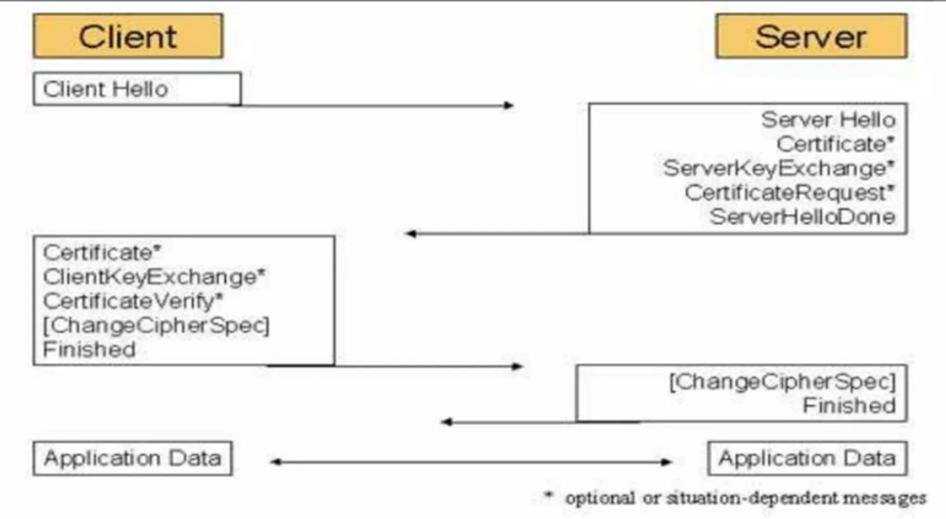
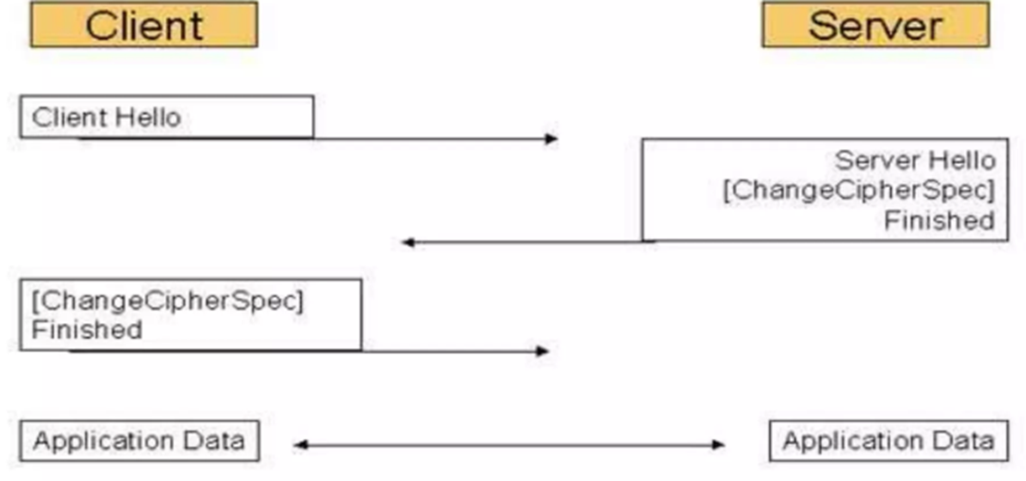
Full VS. ABBREVIATED HANDSHAKE
Full
Abbreviated

